Slide 1


HVS​
Concept of Torque path Management

Slide 2

Contents
Vehicle Speed Limit
Torque Limit Control
Torque Filter Control
Torque Zero Crossing Former
Torque Coordinates
Transmission protection Torque
Motor Control Mode Mapping
Motor Damping Control

Slide 3
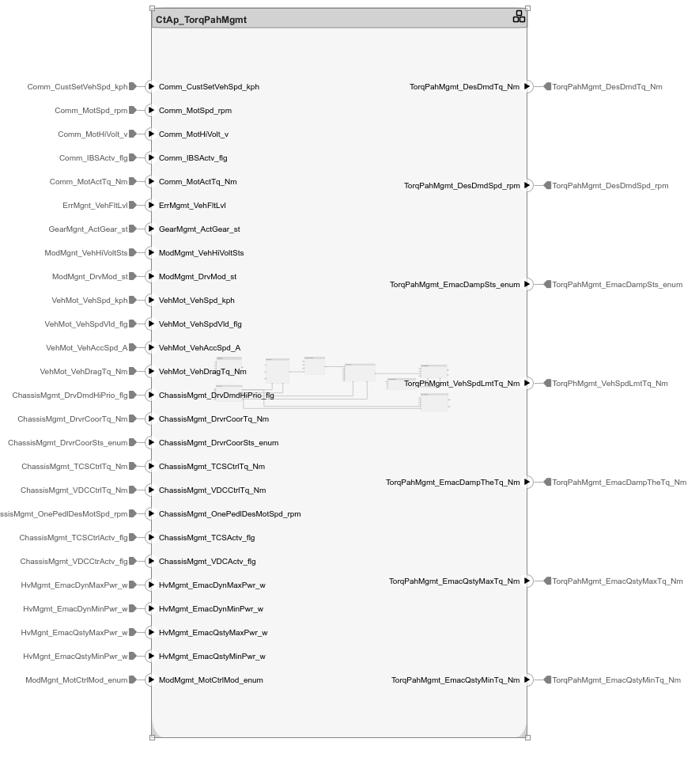
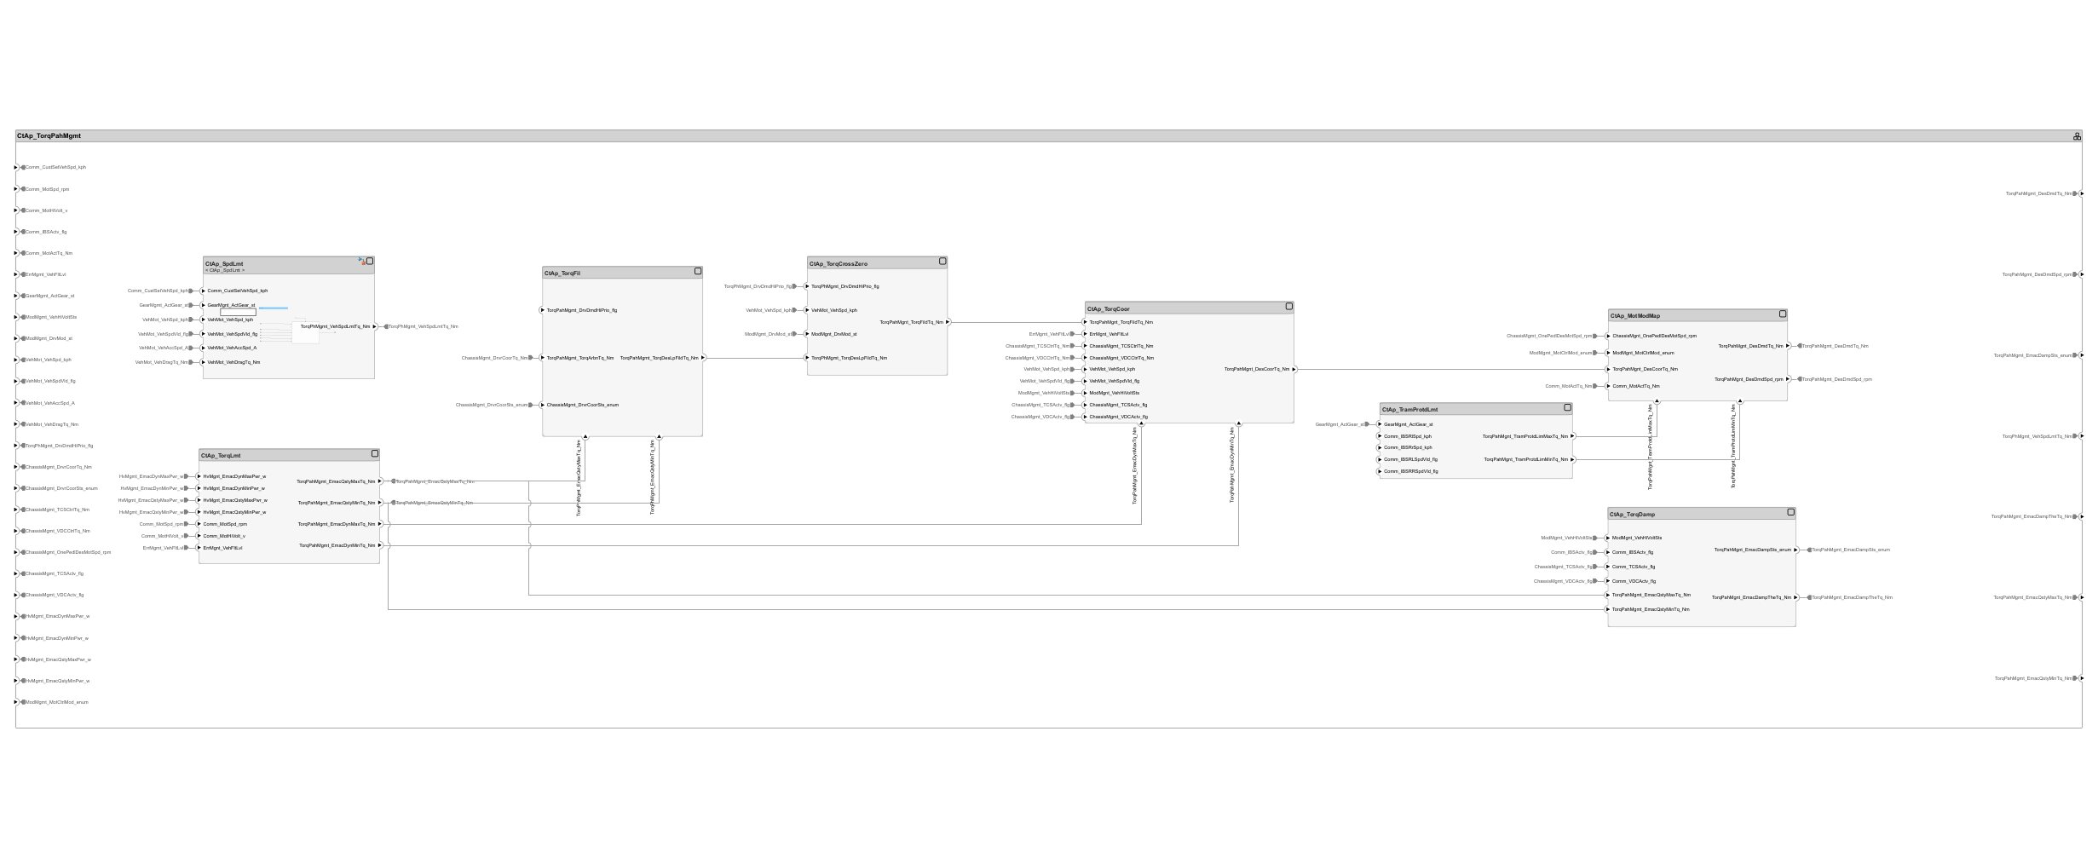
Function Behavior

Slide 4
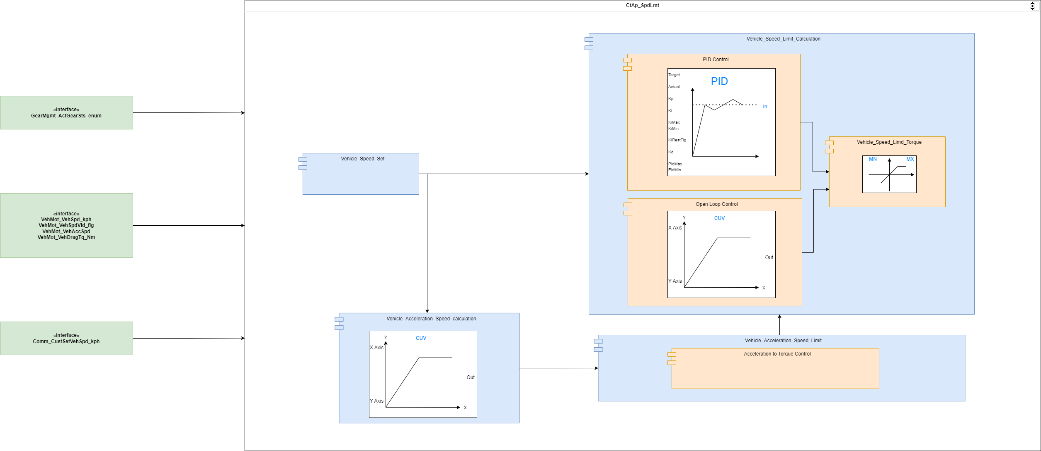
Vehicle Speed limit control
The Longitudinal speed limiter module limits the vehicle velocity to the speed limitation value set. The speed limitation value is provided by the HMI input or by the tester input. Variable speed limiters that accept driver input as speed limit is not implemented in the current design.

Slide 5
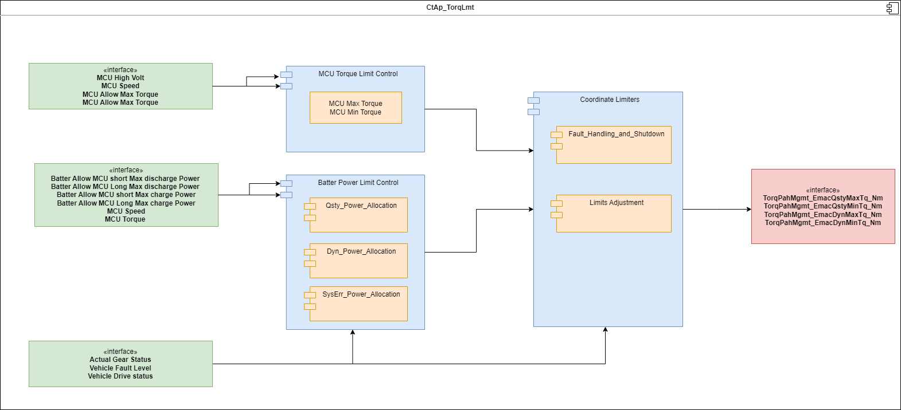
Torque Limit Control
Maximum and Minium torque limits of the Motor are provided after considering
Torque limits from HvMgnt funtion, which takes into account the limits arrived based on the Battery SOC, Temperature and electrical auxillaries consumption
Torque limits from Motor, which provides mechanical limits of the e-motor considering the temperature dependency and efficiency Minimum and Maximun torque limits during error conditions which is calculated in the hierarchy "Fault Handling and Shutdown"

Slide 6
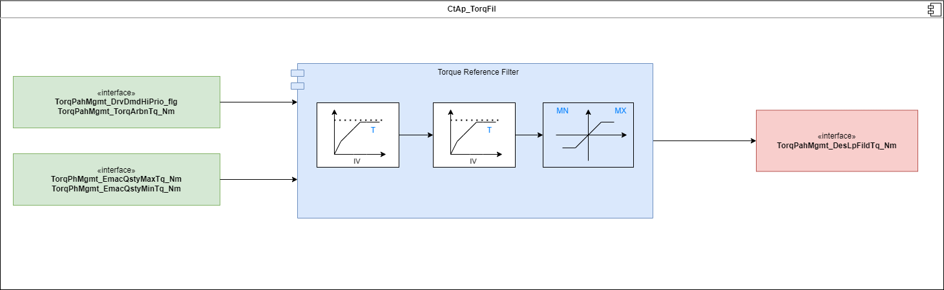
Torque Filter Control
The objective of the function is to minimize the excitations on the drivetrain that would arise by strong jumps, by means of filtering the pre-coordinated demand torque of the Motor.

Slide 7
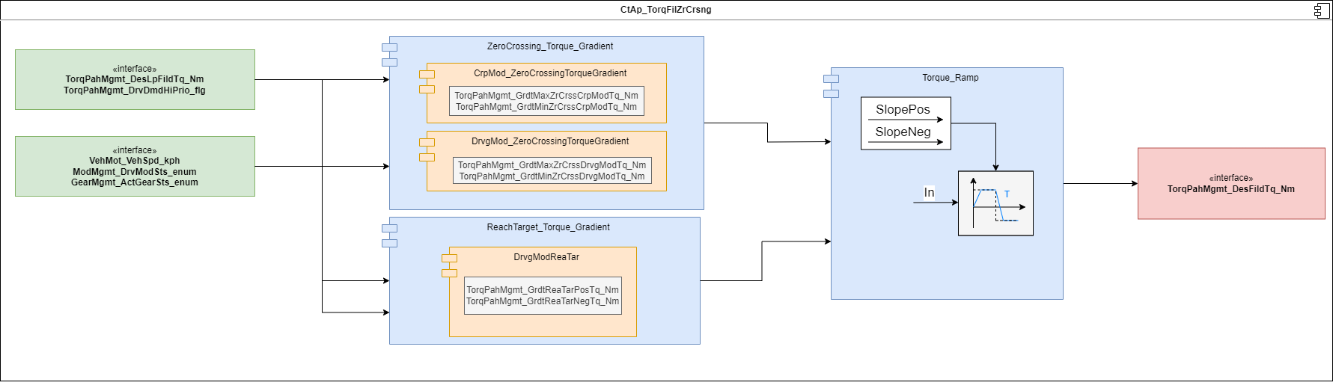
Torque Cross Zero Former
The objective of the function is to form the demand torque for positive/negative load-reversal. The objective of the formation is to prevent that the torque shows too large gradients in the range of zero torque at transmission output level.
The function determines the filtered desired primary axle torque by a smoothing of prefiltered desired propulsion torque on motor for smooth transition from overrun to pull and vice versa.

Slide 8
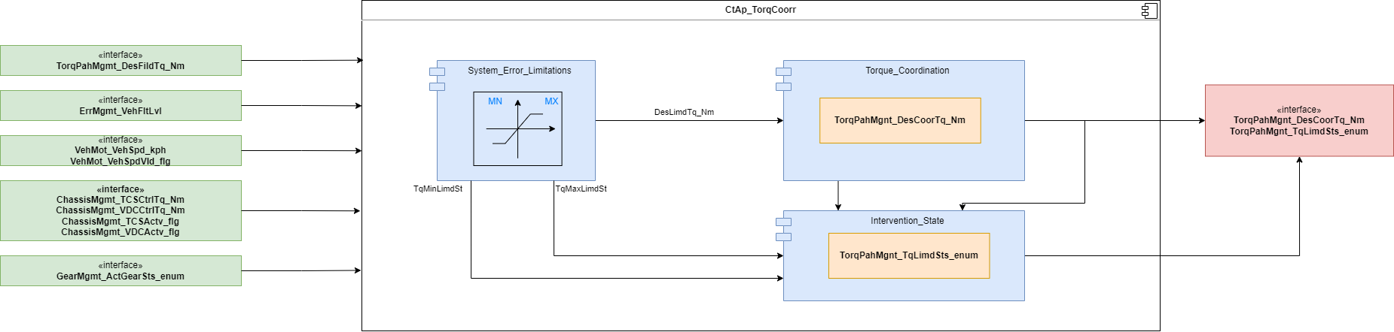
Torque Coordinator
The function Torque coordinates the set point torque with torque interventions from the electronic stability program (ESP)
The torque TorqPahMgmt_DesFildTq_Nm is used directly as the desired wheel torque of E-motor before ESP interventions TorqPahMgnt_DesCoorTq_Nm.
The desired driver demand torque TorqPahMgmt_DesFildTq_Nm (desired motor torque before intervention) is coordinated with the DCS (drag control system) intervention torque ChassisMgmt_VDCCtrlTq_Nm and the TCS (traction control system) intervention torque ChassisMgmt_TCSCtrlTq_Nm

Slide 9
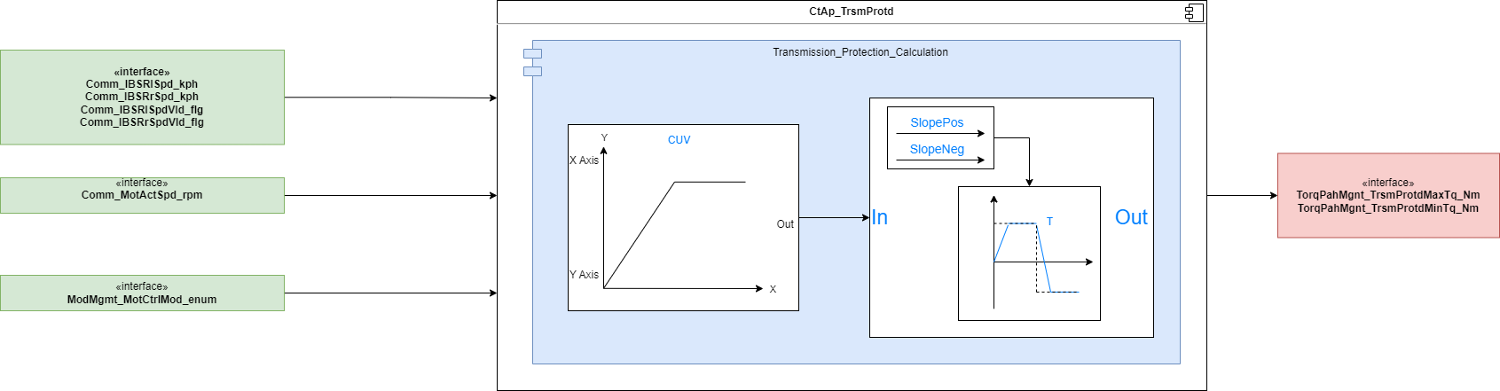
Transmission Protection Mapping
The component generates the minimum (negative) and maximum (positive) transmission protection torque limits of transmissions between machine and wheels differential transmissions.

Slide 10
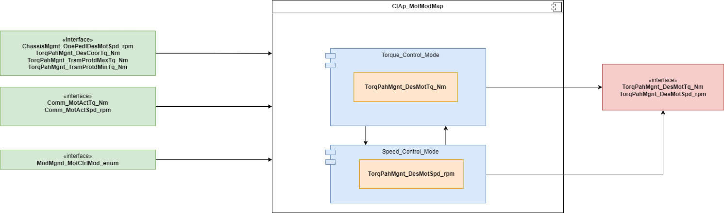
Motor Mode Mapping
The function Motor mode mapping the set torque and speed from the Motor mode
In operation mode (normal mode for torque control or speed control) the limits and controller parameters are set
When the operating mode changes, the desired speed/torque is filtered and emitted

Slide 11
Backup

